Slide 1
Managing Classrooms

Slide 2
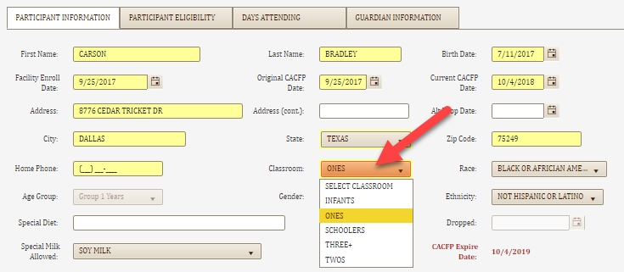

Facility/Manage Classrooms
Adding classrooms may be done before adding participants
Participants may be assigned to a classroom when enrolled
Participants not assigned to a classroom when enrolled will default to the “UNASSIGNED” classroom
The screen above is found in Participant/Participant Information

Slide 3
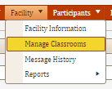
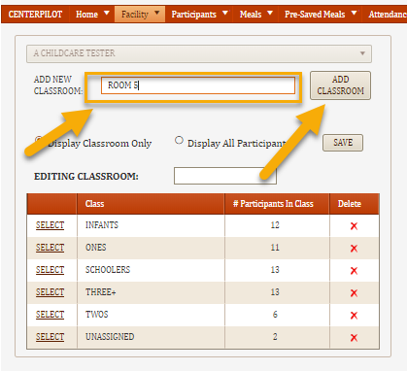
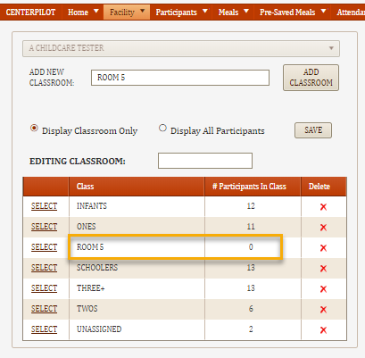

Facility/Manage Classrooms
To Manage Classrooms, click on Facility/Manage Classrooms
To ADD classrooms
Insert the NAME of the classroom
Click ADD CLASSROOM
The classroom will show up in the grid below and show 0 since no participants have been added to the new classroom yet

Slide 4
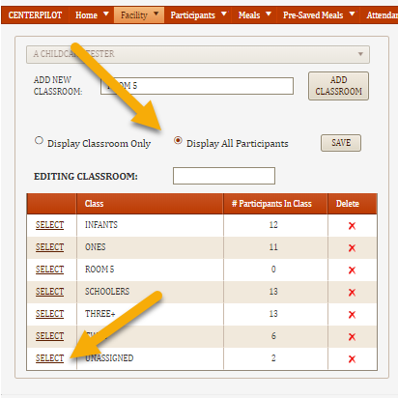
Facility/Manage Classrooms
To ASSIGN CHILDREN to Classrooms
Choose the classroom you wish to transfer FROM, OR
Click on Display All Participants to re-assign several at once
The names of the participants in the selected class (or ALL) will show up in the grid to the right

Slide 5
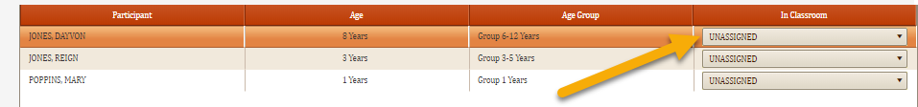
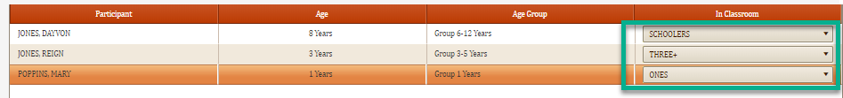
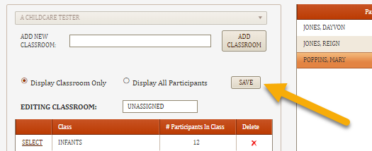
Facility/Manage Classrooms
In the grid on the right, click on the drop down menu to select the classroom to transfer participant TO.
You may assign classrooms one child at a time, or all at once. When classrooms have been assigned, click on SAVE to the left.

Slide 6
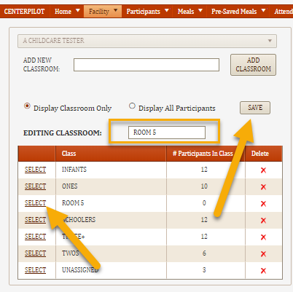
Facility/Manage Classrooms
To CHANGE THE NAME of a classroom
Select the classroom
The name of the classroom appears in the EDITING CLASSROOM cell
Edit the name of the classroom and click SAVE
The new classroom name will be added to the grid and be assigned to all children in that classroom

Slide 7
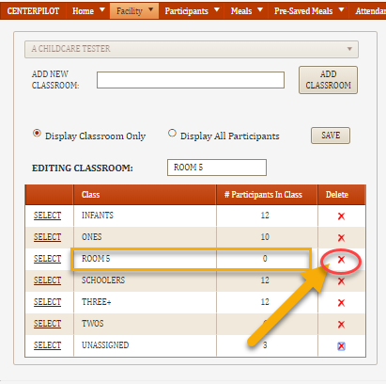
Facility/Manage Classrooms
To DELETE a classroom
Be sure all children in the classroom have been reassigned to other rooms and that a “0” shows next to the classroom name
Click on the red “X” to delete the classroom
A pop-up will confirm you want to delete the room, click OK
The classroom will disappear from the list

Slide 8
Facility/Manage Classrooms
This completes the Training of Managing Classrooms. Please continue with the next training on Adding Participants.

